Slide 1
Colburn Hill Group
The Patient Access Tango:
A Case Study

Slide 2
Patient Access Tango
Presenter
Sarah Lovell is with Colburn Hill and has been a Patient Access consultant with more than 25 years of Revenue Cycle experience. She has an extensive background in patient access operations having served in multiple leadership roles, overseeing a variety of settings ranging from critical access to acute care hospital settings. She currently resides in the Midwest with her two children and four FAT cats.

Slide 3
Patient Access Tango A Case Study
Organizational Overview
Our client is an Academic Medical Center (AMC) located in the Southeast. The organization is designated as a Level I trauma center that includes a children’s hospital, a community health center and other non-acute facilities.
Hospitals
Licensed Beds
Net Patient Revenue
Medical Specialties
Employed Physicians
3
811
$1.8B
200
800
Revenue Cycle / Patient Access Background
A structured, organized Revenue Cycle is somewhat new to this AMC within the last five years. During that time, the Organization hired its first formal Patient Access Director with oversight for Emergency Department registration, financial clearance for scheduled diagnostics and admissions, and financial counseling functions.

Slide 4



Patient Access Tango A Case Study
Overview
By following a structured process, this organization was able to assess operations, standardize processes and improve outcomes in some of the key areas of their Patient Access department.
Leadership strategically set the priorities for the management team to focus on three specific areas:
  Patient Access Training and Policies
  Emergency Department Registration Functions
  Pre-service Financial Clearance – Clearance Days Out
These are the case studies that we will discuss today.

Slide 5
Patient Access Tango A Case Study
The work kicked off with on-site assessment within the Patient Access department:
  Observing staff perform their jobs as they are performing it in real time
  Interviewing front line staff: “What works? What doesn’t?”
  Review – policies, standards, and adjudicated accounts
  “Walking the walk” – train for the role and actually perform the work
Once the workflows and observations were documented, work began committees were established for the planning, documenting and implementation phases for the desired standardization.
Once improvements were implemented, the team measured outcomes to ensure that adjustments to the work had a favorable outcome and did not require further adjustment.

Slide 6
Patient Access Case Study – Agenda
Agenda
  Assessment
    Patient Access Training and Policies
    Emergency Department
    Financial Pre-service
  Standardization
    Patient Access Training and Policies
    Emergency Department
    Financial Pre-service
  Measurement – Improved Outcomes
    Patient Access Training and Policies
    Emergency Department
    Financial Pre-service

Slide 7


This Photo by Unknown Author is licensed under CC BY-SA

Slide 8
Assessment
    Patient Access Training and Policies

Slide 9
Assessment Patient Access Training and Policies
What did assessment in this area look like?
Committee members attended registration training courses offered by the IT department and reviewed current departmental policies in place.
Findings:
  Training focused on registration system instruction incorporating Patient Access subject matter at the same time
  Subject matter references and instruction were very limited
  Testing was brief and broad with a pass/fail scoring approach
  “Refresher” courses were available, but not required beyond the initial training
  There were very few policies established for the department

Slide 10

Assessment Patient Access Training and Policies
The Conclusions were UNANIMOUS….
TOO LITTLE:
Training only covered brief Patient Access related topics along the way
Departmental policies were not part of the onboarding process
YET TOO MUCH all at once:
It would be best to train subject matter first and separately
Providing a “hands on” course post 30 days on the job is needed
TOO INFREQUENT:
Training should be held annually

Slide 11
Assessment
    Emergency Department

Slide 12
Assessment Patient Access Training and Policies
What did assessment in this area look like?
Committee members partnered up with Emergency department staff members during their active shift to ‘shadow’ the work and interview in between tasks. Available metrics, standards and policies were reviewed.
Three immediate areas of opportunity were noted:
  Management Structure
  Registration/payer accuracy
  Co-pay collection

Slide 13
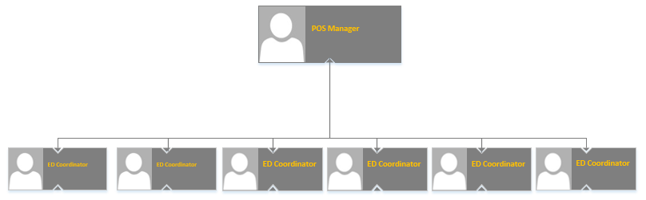
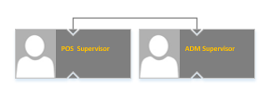

Assessment Emergency Department
Assessment: Management Structure
FTE
FTE
FTE
FTE
FTE
42 FTEs
3 Shifts
FTE
FTE
23 FTEs
3 Shifts
FTE
FTE
FTE
FTE
FTE
FTE
FTE
  Existing Management structure required one Manager to lead multiple departments
  “Flat” ORG structure in ED created a void in supervision and oversight, placing extreme pressure on the POS Manager and the overall departmental performance
  The organization has additional check-in areas to centralize under POS in the future

Slide 14









Assessment Emergency Department
Assessment: Registration/Payer Accuracy
  Initial denial data was not available to the Emergency Department – performance unknown
  Onboarding staff received “One time” classroom training on the ADT system
  Real time eligibility technology & procedures were not in place (performed retrospectively)
This way
That way
Uncertain
Confused
Perplexed
Unclear

Slide 15
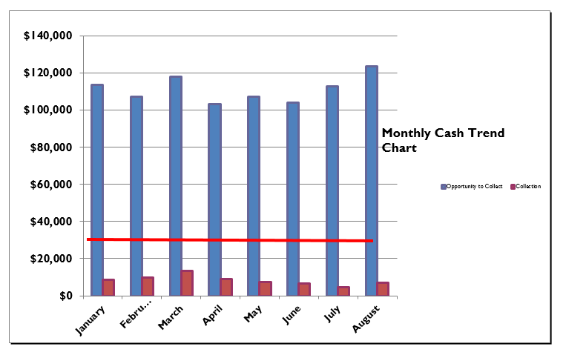
Assessment Emergency Department
Assessment: Co-pay Collections
  Data was tracked manually without reconciliation to cash posted / transacted
  Policy and training materials were outdated
  Staff was not feeling confident with the process
TOTAL MONTH | January | February | March | April | May | June | July | August | September
Opportunity to Collect | $113,605 | $106,898 | $117,732 | $103,169 | $106,938 | $103,755 | $112,692 | $123,504
Collection | $8,411 | $9,694 | $13,351 | $8,931 | $7,230 | $6,647 | $4,553 | $6,806
% Met (collected over oppprtunity) | 7% | 9% | 11% | 9% | 7% | 6% | 4% | 6%
A departmental goal had been established, but staff was not well versed on what the goal was and why the goal was important.

Slide 16
Assessment Patient Access Training and Policies
What did assessment in this area look like?
At the time of assessment, the Management position in this department was vacant. The Patient Access Director elected a qualified candidate from Committee to serve as the interim leader. The interim leader met with department stakeholders and shadowed staff. Available metrics, standards and policies were also reviewed.
Three immediate areas of opportunity were noted:
  Staff work drivers and workflows
  Stakeholder partnerships
  Measurement - no facts to monitor performance

Slide 17
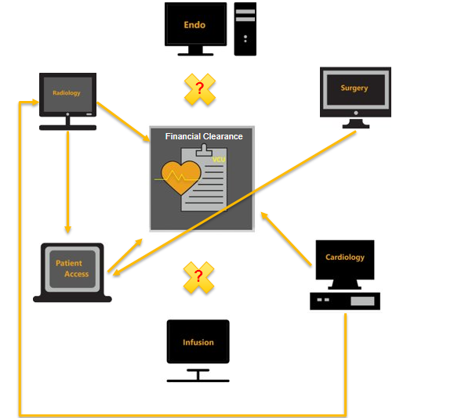
Assessment Financial Pre-service
Assessment: Financial Clearance Days out
The Pre-service Clearance staff handled partial scope for multiple departments. These all had different expectations of the prior-authorization process:
Departments managed their own scheduling process
Patients were scheduled without RTE or consideration of the established payer turn-around time expectations
Peer-to-peer Requests
Delay/rescheduling rules for patients without Prior Authorizations

Slide 18

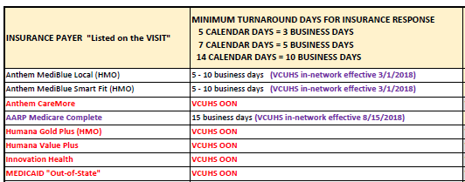


Assessment Financial Pre-service
Needless to say … NO ONE involved was happy!
Average “days out” performance was 3 to 6 calendar days out from Date of Service.
Minimum ‘TAT’ required 5 – 10 business days
Patient delays/cancellations
Administration exercising extreme patience
PA department feeling
beat up

Slide 19
Patient Access Tango Standardization
  Standardization
    Patient Access Training and Policies
    Emergency Department
    Financial Pre-service

Slide 20

This Photo by Unknown Author is licensed under CC BY-SA-NC

Slide 21
Assessment
    Financial Pre-Service

Slide 22

Standardization
Patient Access Training and Policies

Slide 23
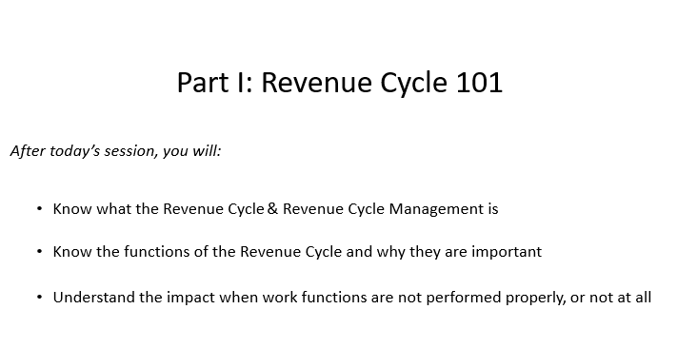
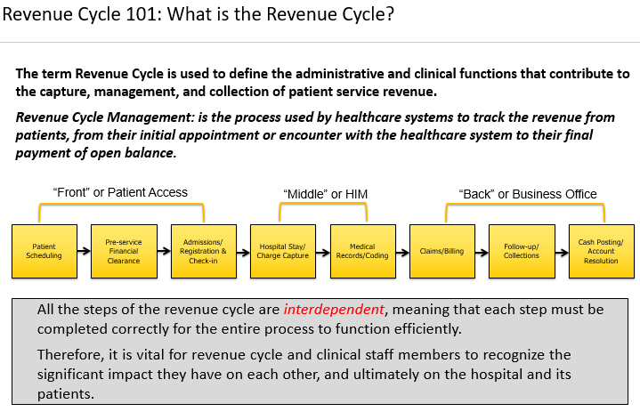
Standardization Patient Access Training and Policies
Materials were developed and customized to the needs of the Organization:
  Live classroom instruction was offered “pre-pandemic”
  The courses were recorded and delivered remotely “post-pandemic”
  The training was mandatory for all Patient Access staff
  Written tests & passing requirements were enforced

Slide 24
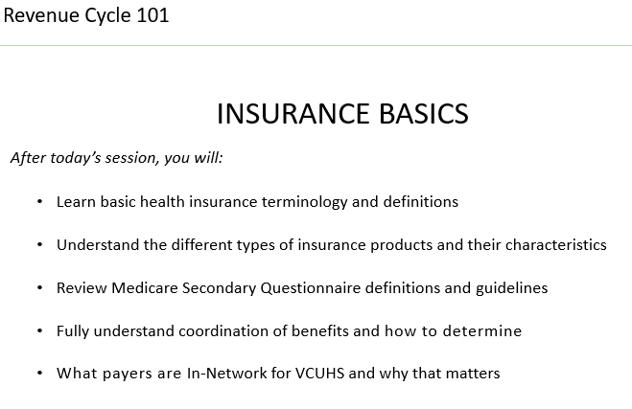
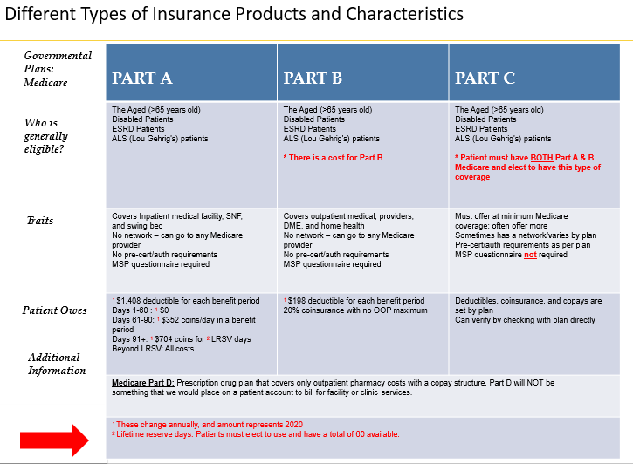
Standardization Patient Access Training and Policies
Training included the “basic” terminology that staff would hear when they arrived at IT Registration training.
us
Instruction spent time laying out the general structure of health insurance payers - such as the characteristics of commercial and governmental products.

Slide 25
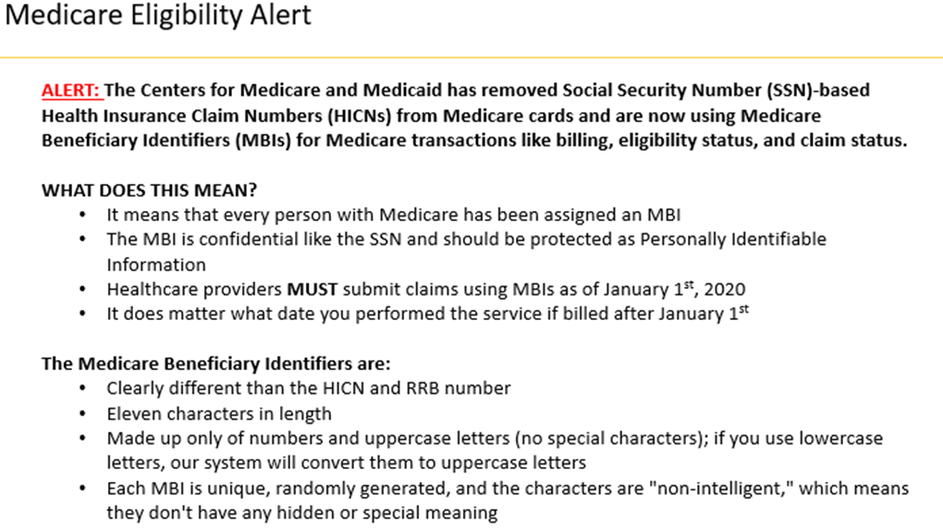

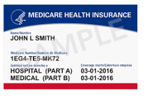
Standardization Patient Access Training and Policies
Instruction was also given on how to avoid denials currently trending in the billing office ..

Slide 26
Standardization Patient Access Training and Policies
Policies and procedures were created and/or updated at this same time…
Departmental Policy Title | Purpose
Emergency Preparedness Policy | To provide guidance for the continuation of essential functions and services to support patient care during periods of office closings related to inclement weather, utility outages, or other unforeseen circumstances.
Cash Handling Policy | To establish cash handling procedures for all hospital service areas. This policy will address the technology used, which will help the Health System address the growing patient out-of-pocket challenges through the patient payment experience and provide meaningful financial results for the organization.
Important Message from Medicare (IMM) | To comply with the Centers for Medicare and Medicaid Services (CMS) regulatory requirement that hospitals notify Medicare beneficiaries who are hospital inpatients about their discharge rights.
Medicare Secondary Payer Questionnaire (MSPQ) | The Medicare Secondary Payer Questionnaire Policy defines the goals and procedures for ensuring compliance with regulatory requirements and to provide consistent direction for Patient Access and other staff responsible for registration, with respect to the completion of the Medicare Secondary Payer Questionnaire (MSPQ) and the Medicare insurance prioritization.
Scheduling Policy | To ensure efficient access to care in a timely and non-discriminatory manner by maximizing utilization of available resources. It is also the goal of this policy to minimize the Health System’s exposure to financial loss from insurance payers, other third parties, and patients as well as to minimize the patient’s liability and exposure to financial loss from the insurance payers.
Financial Clearance Policy | The Financial Clearance Policy defines the goals and procedures, to ensure all appropriate steps are taken prior to service, for minimizing the Health System’s (VCUHS) exposure to financial loss from insurance payers, other third parties, and patients. It is also the goal of this policy to minimize the patient’s liability and exposure to financial loss from the insurance payers.
Patient Registration Policy | The Patient Registration Policy defines the goals and procedures for ensuring the collection of complete patient demographic and insurance data while minimizing the Health System’s exposure to financial loss from insurance payers, other third parties, and patients. It is also the goal of this policy to minimize the patient’s liability and exposure to financial loss from the insurance payers.
Emergency Room Registration | The Emergency Registration Policy defines the goals and procedures for ensuring the collection of complete patient demographic and insurance data while minimizing exposure to financial loss from insurance payers, other third parties, and patients to all entities.
Identity Theft | The Identity Theft Policy defines the goals and procedures surrounding any form of identity theft at VCU Health. This policy will outline ways for PARs and other registration staff to detect, prevent and mitigate identity theft.
Freedom Impaired (Prisoner) Policy | To define safety parameters to be used in the event a prisoner patient presents to a Patient Access Registration department open to the general public, as well as, Health System staff members.
Patient Access Complaint Policy | This policy will provide guidance to associates, supervisors and managers regarding the acknowledgment, resolution and appropriate escalation of both external and internal customer complaints.

Slide 27
Standardization
    Emergency Department

Slide 28
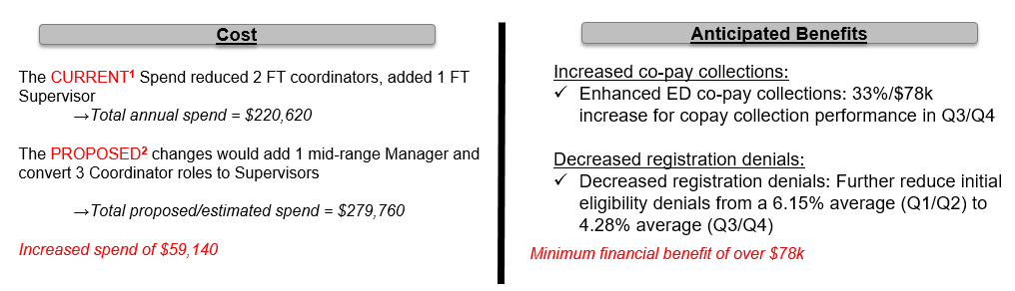
Standardization Emergency Department
Job roles and responsibilities were mapped out/defined. A business case was submitted for approval.
Role​ | Reports To​ | Time spent on the “Front Line”​ | Focuses Remaining Time​
​ Patient Access Director​ | ​ Revenue Cycle Director ​ | ​ 10% for observation and connecting w/front line staff.​ | ​Ensuring compliance​ Driving performance​ Representing the dept. to internal stakeholders​ Various strategic initiatives​
​ Manager​ Point of Serv.​ Pre-service.​ Emergency​ Financial counseling​ ​ | ​ Patient Access Director​ | ​ 25% observing, connecting with staff and actually performing tasks. ​ | ​Driving compliance​ Customer Satisfaction and Problem Solving​ Driving performance​ Time/Attendance​ All HR related needs​ Various Mtgs. & initiatives ​
​ Supervisor or Team Lead​ | ​ Manager​ | ​ 50% performing tasks along side or in place of front-line staff. ​ | ​Staff scheduling​ Day to day questions ​ Other duties as assigned​
​ Education/QualityCoordinator​ | ​ Patient Access Director​ | ​ 25% observing and connecting with front line staff.​ | ​Annual Training​ Educating Front line staff​ Regular QA monitoring​ Continuing Education ​

Slide 29





Standardization Emergency Department
To guide the initiatives moving forward, the organization created committees that met weekly:
  The committee consisted of about 5-10 patient access leaders & stakeholders
  Both supervisory and front-line staff were included in the project
Example of Emergency Department Registration Quality Committee Initiatives
Secure minimum data set revealing registration quality
Perform gap analysis on current training and on boarding process
Review / update / create registration policies
Define current state & future state workflows
Identify system needs & Implement
Develop / update training materials and policies
Standardize Patient Access department onboarding process
Create a reporting cadence and establish goals
Develop operational cadence between management team & front line
Go Live with future state process

Slide 30


Slide 31
Standardization
    Financial Pre-Service

Slide 32
Standardization Financial Pre-service
The planning and mapping phases for the pre-service functions began with establishing
partnerships with stakeholders. Radiology was chosen.
Weekly meetings between Radiology and FPS were scheduled
Together, the team developed a list of issues/barriers impacting
  FPS late starts on authorization process
  Peer to Peer (P2P) process issues
  Inconsistent process for delay/reschedule process
Immediate corrective actions were identified, resolution paths were developed, and outcomes were tracked and discussed during the meetings
Continuous process improvements were incorporated into the Patient Access project plans
The blended team presented barriers to the Clinical leaders
Details regarding the “who, what, where & whys” of Peer to Peer requests were co-presented
Administrative point of contacts were established for escalation purposes

Slide 33
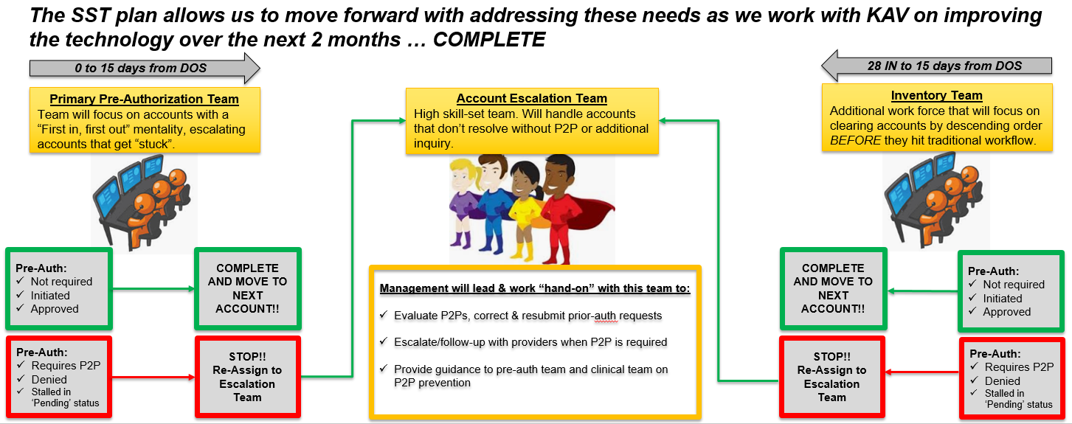
Standardization Financial Pre-service
Workflows for the financial pre-service team was designed to address:
  Timeliness of pre-service “first touch”
  Multiple touches by staff that slow down productivity
  Timelier escalation when there is a barrier to securing a valid prior-authorization

Slide 34
Standardization Recap
  In conclusion, this Standardization was successful because:
    We had a detailed plan, action owners, and timelines
    Processes and workflows that established the standards were well documented and socialized
    Expectations were clear and were mandatory
    We had a back up plan (*sigh* - COVID)

Slide 35
Measurement
    Patient Access Training and Policies

Slide 36
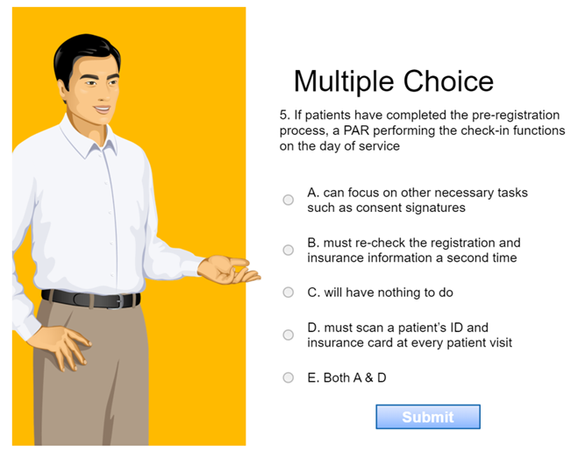
Measurement Patient Access Training and Policies
All Patient Access Training Materials were accompanied with:
  Random test questions that were multiple choice, True/False or ‘fill in the blank’
  A passing score of 80% or higher was required to move forward
  Multiple versions of questions were developed to avoid the temptation to ‘cheat’

Slide 37


Slide 38
Measurement
    Emergency Department

Slide 39
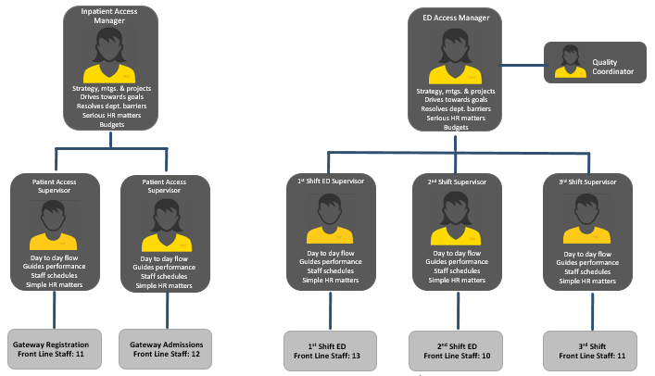
Measurement Emergency Department
The final structure meets the needs of the departments.
  Span of Control
  Quality Assurance & Training
  Day to day performance

Slide 40


Measurement Emergency Department
Positive outcomes are attributed to the assessment and standardization efforts in the ED ….

Slide 41
Measurement
    Financial Pre-Service

Slide 42
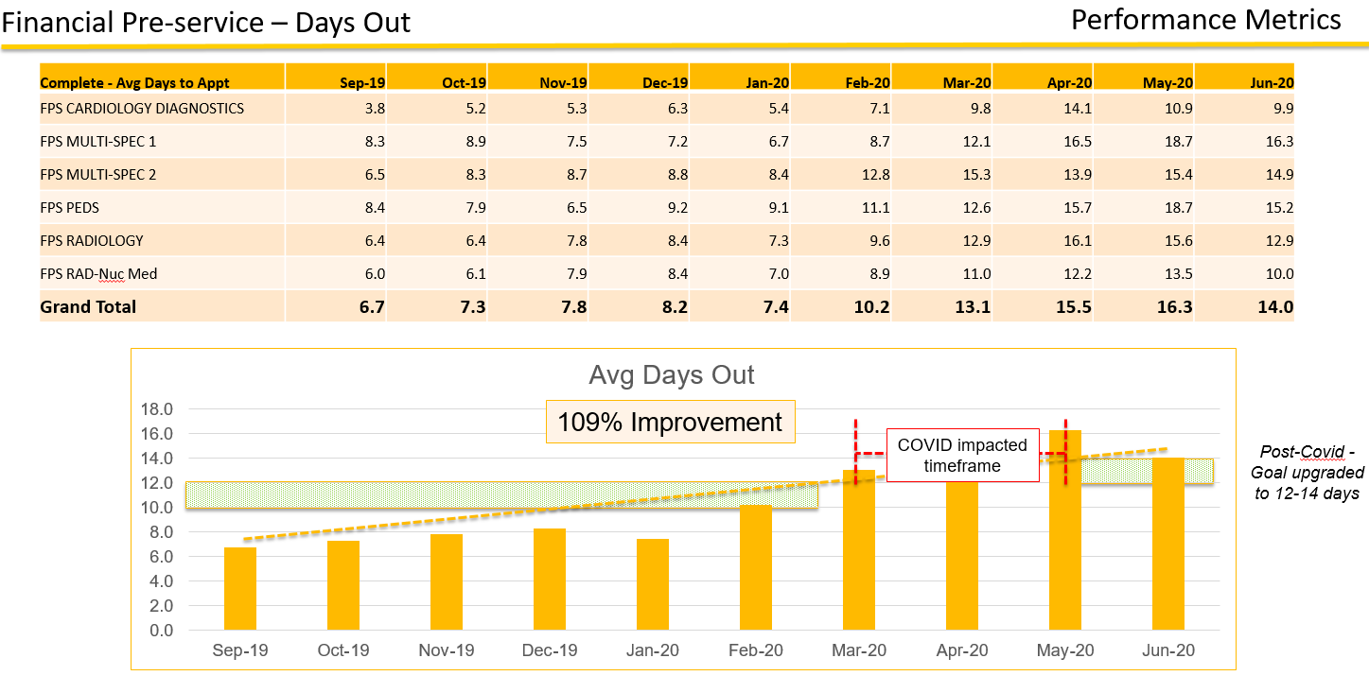
Measurement Financial Pre-service
Beginning a workflow in “reverse date order” has resulted in higher days out performance.

Slide 43
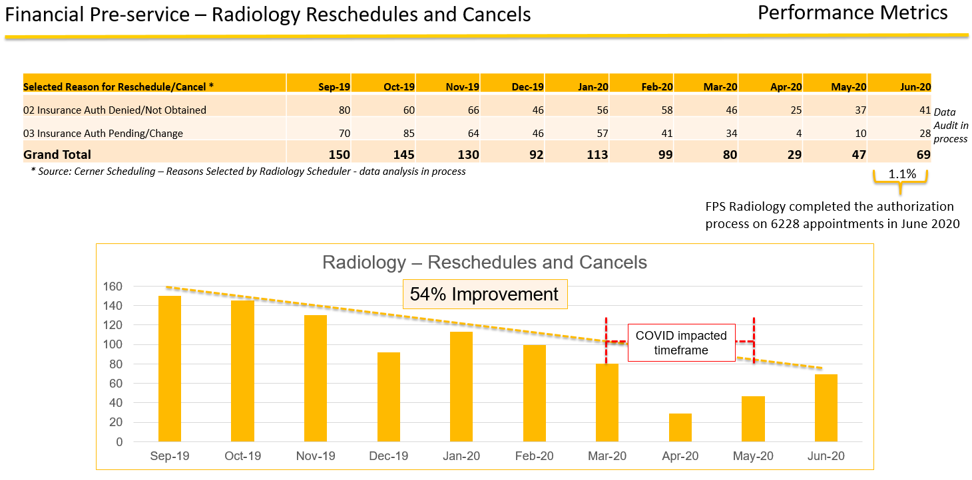
Measurement Financial Pre-service
Improved “days out” performance has driven down the # of delayed or rescheduled tests…

Slide 44
Measurement Recap
Measurement – keep it simple:
“What gets measured gets done”
You do not need spreadsheets of data and fancy dashboards
Focus on key outcomes or issues and back into the measurement

Slide 45


Slide 46
Patient Access Tango
Thank you!
Please feel free to contact me if you have any questions, comments, or would like to talk through strategies.
slovell@colburnhill.com
269-350-1393

